Slide 1
Movie recommendation engine

Slide 2

Name - Debanjan Bhattacharya University Roll No. 12018009019006
Name - Soumyadeep Maji University Roll No. 12018009019307
Name - Shouryadeep Mahato University Roll No. 12018009019576
Name - Aniket Roy University Roll No. 12018009019188
Name - Arkadyuti Dam University Roll No. 12018009019654
Name – Soumyajit Roy University Roll No. 12018009019386

Slide 3
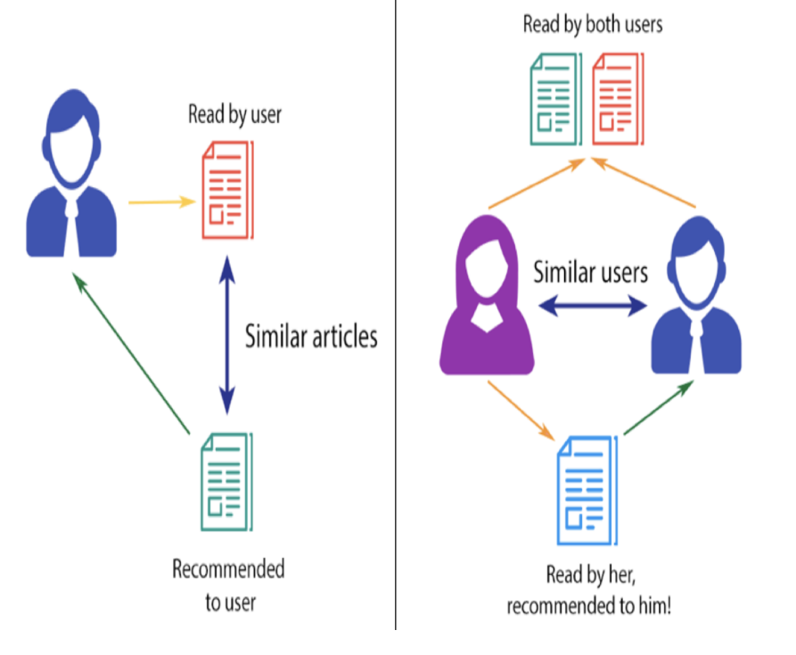
What is recommendation engine?
A recommender system is an information filtering system that seeks to predicts the rating given by a user to an item. This predicted rating then used to recommend items to the user.

Slide 4
Why do we need recommendation engine?
There are mainly three benefits of using recommendation engine:-
Retention-core potential benefit of recommendation systems is their ability to continuously calibrate to the preferences of the user.
Scaling-By using various means of “filtering”, eCommerce giants can find opportune times to suggest (on their site, via email, or though other means) new products that you’re likely to buy.
Brand Loyalty- With personalized recommendations, it is more likely that customers will engage more with the current system.

Slide 5
Use cases
If we closely look at the brands link Netflix, Amazon, YouTube, Myntra, etc, they all provide us recommendations.
In Netflix, 75% rented movies are from recommendation
In Google, -38% are more click-through are due to recommendation
In Amazon, 35% are sales from recommendation

Slide 6
Recommendation Engine Architecture
One common architecture for recommendation systems consists of the following components:
Candidate generation :In this first stage, the system starts from a potentially huge corpus and generates a much smaller subset of candidates. For example, the candidate generator in YouTube reduces billions of videos down to hundreds or thousands.
Scoring : Next, another model scores and ranks the candidates in order to select the set of items (on the order of 10) to display to the user.
Re-ranking : Finally, the system must take into account additional constraints for the final ranking. For example, the system removes items that the user explicitly disliked or boosts the score of fresher content.

Slide 7
Types of Recommendation Engine

Slide 8
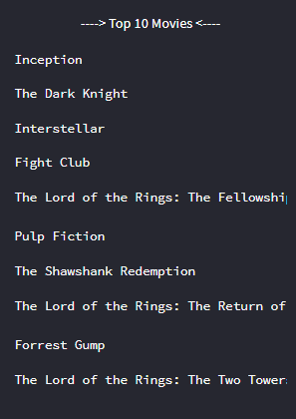
Simple recommender
The Simple Recommender offers generalized recommendations to every user based on movie popularity and (sometimes) genre. The basic idea behind this recommender is that movies that are more popular and more critically acclaimed will have a higher probability of being liked by the average audience.
We will sort our movies based on ratings and popularity and display the top movies of our list. As an added step, we can pass in a genre argument to get the top movies of a particular genre.

Slide 9
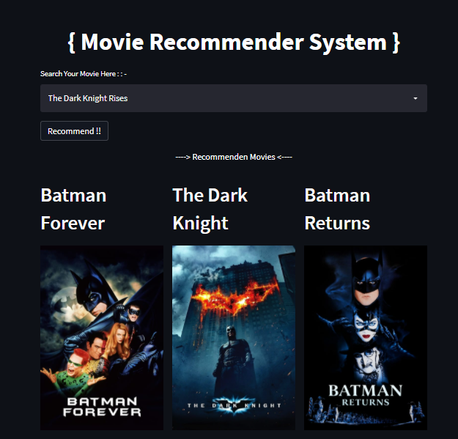
Content-Based recommender
Content-based filtering uses item features to recommend other items similar to what the user likes, based on their previous actions or explicit feedback.
Content here refers to the content or attributes of the products you like. So, the idea in content-based filtering is to tag products using certain keywords, understand what the user likes, look up those keywords in the database and recommend different products with the same attributes.

Slide 10
How does Content Based Filtering occur?
In simple words scoring refers to the process of listing the items and deciding which one will go in which position. In this part, two concepts are used:
Term Frequency (TF) and Inverse Document Frequency (IDF) and Vector Space Models
Cosine Similarity

Slide 11
TF and IDF
TF or Term Frequency refers to the process of finding relevant words in a document by finding their frequency. The more the frequency, the importance will be more. If two users are found to have a match in the type of words using Term Frequency, then content-based filtering occurs.
TF = 1 + log(TF) if TF > 0
TF = 0 If TF = 0
Many times it is seen that the word which is less frequent or has less frequency has more relevance and this thought is being used in IDF or Inverse Document Frequency.
IDF = log (N/DF)
– N represents the number of documents and DF represents the number of documents in which we see the occurrence of this word.

Slide 12
Cosine Similarity
It is a process of finding similarity between two users by focusing on their ratings.
Suppose two users have rated two movies. Using this data we can find how much similar is their choice by using this formula:
Similarity= cosθ = b.c/(||b|| ||c||)

Slide 13
FUTURE SCOPE
Cosine similarity calculation do not work well when we don't have enough rating for movie or when user's rating for some movie is exceptionally either high or low. As an improvement on this project some other methods such as adjusted cosine similarity can be used to compute similarity.
Adjusted cosine similarity, which is similar to cosine similarity, is measured by normalizing the user vectors Ux and Uy and computing the cosine of the angle between them. However, unlike cosine similarity, when computing the dot product of the two user vectors, adjusted cosine similarity uses the deviation between each of the users’item ratings, denoted Ru, and their average item rating, denoted ¯Ru, in place of the user’s raw item rating.

Slide 14
CONCLUSION
In this project, we have successfully built 2 different types of recommendation engines based on different ideas and algorithms. They can be summarized as follows:
Simple Recommender: This system used overall TMDB Vote Count and Vote Averages to build Top Movies Charts, in general and for a specific genre. The IMDB Weighted Rating System was used to calculate ratings on which the sorting was finally performed.
Content-Based Recommender: We built a content-based engines; one that took movie overview and taglines as input and the other which took metadata such as cast, crew, genre and keywords to come up with predictions. We also devised a simple filter to give greater preference to movies with more votes and higher ratings.

Slide 15
Thank You!

